Slide 1
PAPER 01 · Overview
9 PAPERS
4 TRACKS
大模型基础设施研究方向总览: Chen Tian@NJU
面向模型训练、在线推理、云基础设施运维与下一阶段系统能力演进。
01
训练系统优化
02
推理服务优化
03
可观测与 AIOps
04
未来工作
服务：模型训练开发与部署
服务：在线 LLM serving与用户请求
服务：云基础设施与运维团队
服务：系统协同优化
CORE PAIN
CORE PAIN
CORE PAIN
CORE PAIN
瓶颈跨算子、设备、内存与故 障恢复，人工经验难稳定优化
长上下文与 reasoning 放大 decode 负载，KV cache 与 实例失衡推高延迟/OOM
网络异常会级联扩散 告警与日志巨大，需要非侵入 可解释定位
系统扩展效率不足、资源利用冗余，以及训练-推理行为不一致
PAPERS
USENIX ATC'25
Hermes — training advisor
PAPERS
PAPERS
ASPLOS'25
DVFS — energy efficiency
SIGMOD'26
CoDec — prefix decoding
CAPABILITY
ASPLOS'26
Pulse — RDMA monitoring
构建可扩展协同架构与可靠训练-推理闭环，实现高吞吐、低冗余、可复现的 Agent 系统
ASPLOS'25
Roofline — operator modeling
HPDC'26
STAR — decode rescheduling
SIGCOMM'25
BiAn — network RCA
DAC'26
SmartSwap — dynamic memory
INFOCOM'26
Chameleon — fault tolerance
CAPABILITY
CAPABILITY
CAPABILITY
从kernel 到 scheduler 协同降低 成本、延迟和 SLO 违约
把底层信号转化为运维定位结 论
高吞吐、可扩展、可恢复
Source: local paper set in Research ppt · Overview for talk
01

Slide 2
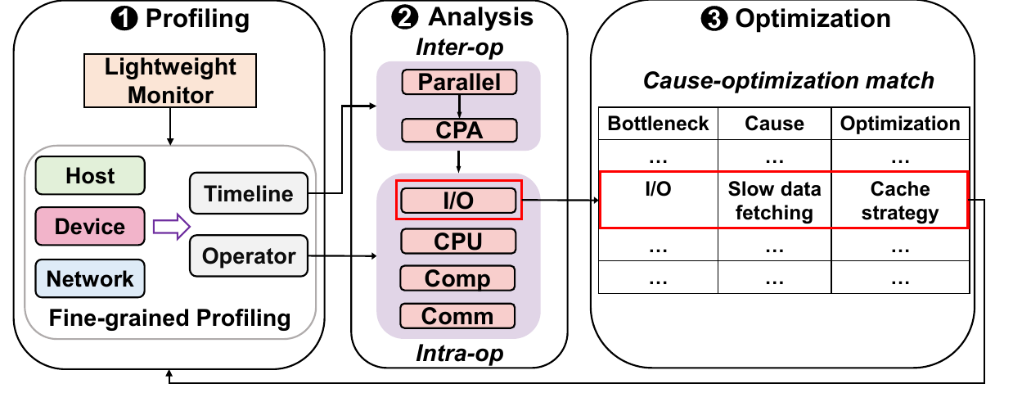
PAPER 02 · TRAINING SYSTEMS
USENIX ATC'25
Hermes：Ascend 训练瓶颈诊断与优化闭环
Accelerating Model Training on Ascend Chips: An Industrial System for Profiling, Analysis and Optimization
PROBLEM
IDEA
RESULT / TAKEAWAY
Ascend 训练瓶颈跨 I/O、CPU 通信和并行策略，人工 profiling 难稳定 定位。
轻量监控发现异常，再按需进入细粒度 profiling，分层定位 inter-op
intra-op / 通信瓶颈。
形成 monitor → diagnose → advise 闭环 把专家经验沉淀成可复用诊断流程。
total time speedup is 3.05x
135 real-world cases
Source: local paper PDF · core figure cropped from paper
02

Slide 3
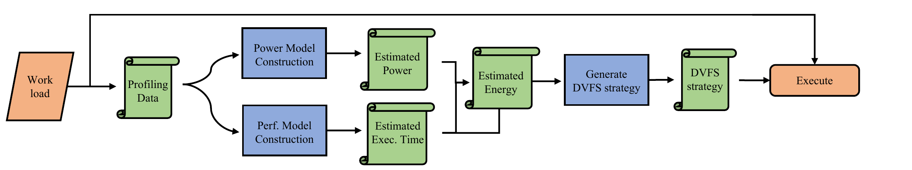
PAPER 03 · TRAINING SYSTEMS
ASPLOS'25
Operator-level DVFS：毫秒级频率调节降低训练能耗
Using Analytical Performance/Power Model and Fine-Grained DVFS to Enhance AI Accelerator Energy Efficiency
PROBLEM
IDEA
RESULT / TAKEAWAY
AICore power -13.44%，
性能损失仅 -1.76%
把 DVFS 推进到算子粒度,在低性能损失
下降低训练能耗
AI 加速器能耗持续上升
传统 program/phase 级 DVFS 捕捉不到毫秒级算子差异，容易省电但损伤训练性能。
构建算子级性能模型，预测不同频率下执行时间
引入温度感知功耗模型估算能耗变化
用算子分类、预处理与搜索生成 SetFreq 策略
Source: local paper PDF · core figure cropped from paper
03

Slide 4
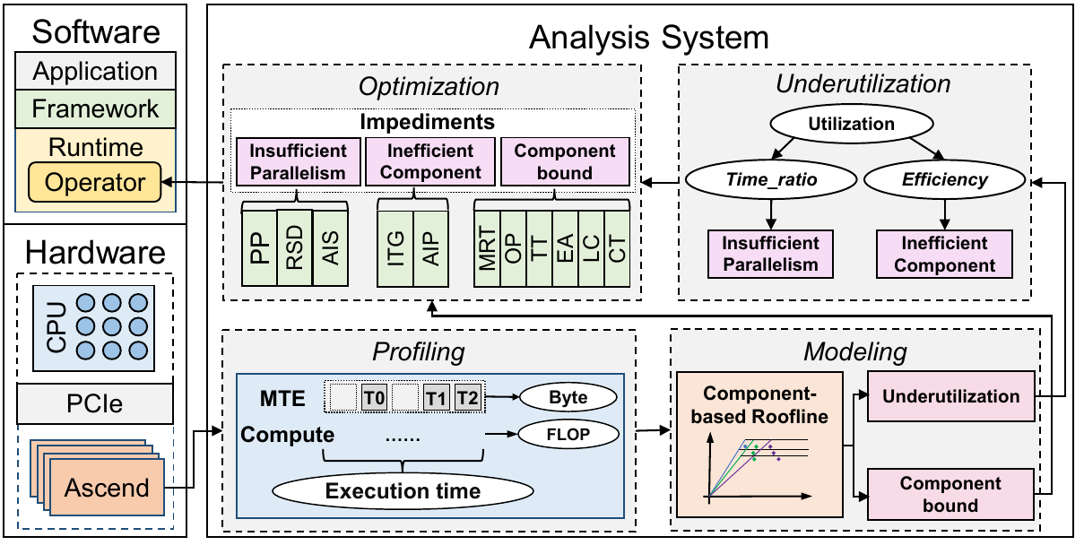
PAPER 04 · TRAINING SYSTEMS
ASPLOS'25
Component Roofline：让 Ascend 算子瓶颈可见
Squeezing Operator Performance Potential for the Ascend Architecture
CORE PROBLEM
Ascend 算子性能受 Cube、Vector、Scalar、MTE 与数据搬运共同限制，传统 Roofline 无法解释组件级串并行和利用率不足。
SYSTEM IDEA
• 抽象 Ascend 硬件组件并建模串行/并行关系
• 构建 component-based Roofline 定位瓶颈组件
• 拆解 underutilization：active time ratio 与 execution efficiency
覆盖11 模型 / 41 算子
端到端提升 1.07×–2.15×
TAKEAWAY
手工优化 → 可视化瓶颈定位+组件级优化
Source: local paper PDF · core figure cropped from paper
04

Slide 5
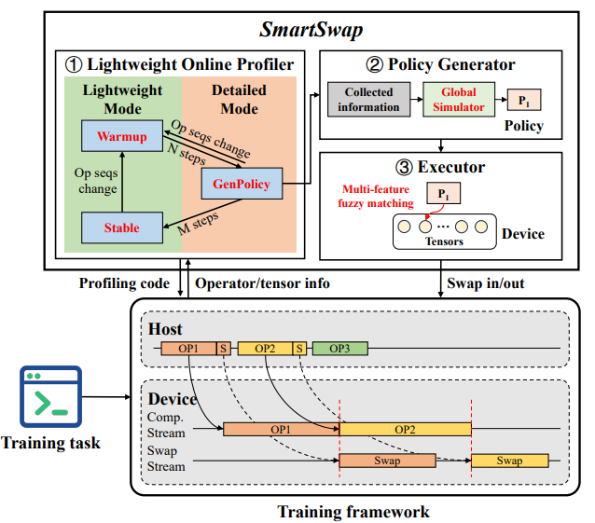
PAPER 05 · TRAINING SYSTEMS
DAC'26
SmartSwap：动态算子序列下的可用 Swap
SmartSwap: Swap-Based Memory Optimization for LLM Training under Varying Operator Sequences
CORE PROBLEM
PyTorch Eager Mode 中条件分支、混合精度和在线验证会改变算子序列，静态 swap 策略容易 OOM、生命周期错配或运行时错误。
SYSTEM IDEA
• 在线 profiler 在 WarmUp、GenPolicy、Stable 阶段间切换
• policy generator 用逻辑层分组和全局模拟器找 swap 时机
• executor 通过多特征模糊匹配与 custom recordStream 执行策略
profiling 开销降低84.25%；支持 4× 超 HBM训练；性能提升38.94%
TAKEAWAY
把依赖固定计算图的 swap 优化，扩展到真实 Eager Mode 动态训练场景。
Source: local paper PDF · core figure cropped from paper
05

Slide 6
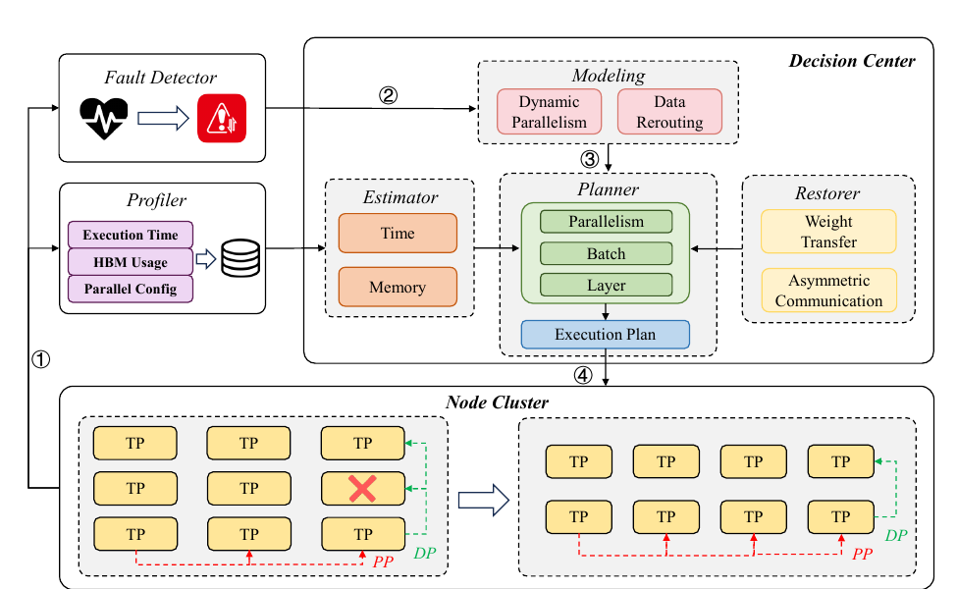
PAPER 06 · TRAINING SYSTEMS
INFOCOM'26
Chameleon-FT：故障后实时选择恢复策略
Chameleon: Adaptive Fault Tolerance for Distributed Training via Real-time Policy Selection
CORE PROBLEM
不同 backup-free 容错策略在开销 恢复时间和恢复后吞吐上各有取舍。
SYSTEM IDEA
• 建模 fault-handling time 与 post-recovery step time • 搜索 DP / PP / batch / layer 分布 生成执行计划 • 用权重迁移匹配与通信优化提升恢复效率
故障后自动选择 data rerouting dynamic parallelism
TAKEAWAY
恢复策略由实时状态与性能模型自动决策
1.355× higher average
Source: local paper PDF · core figure cropped from paper
06

Slide 7
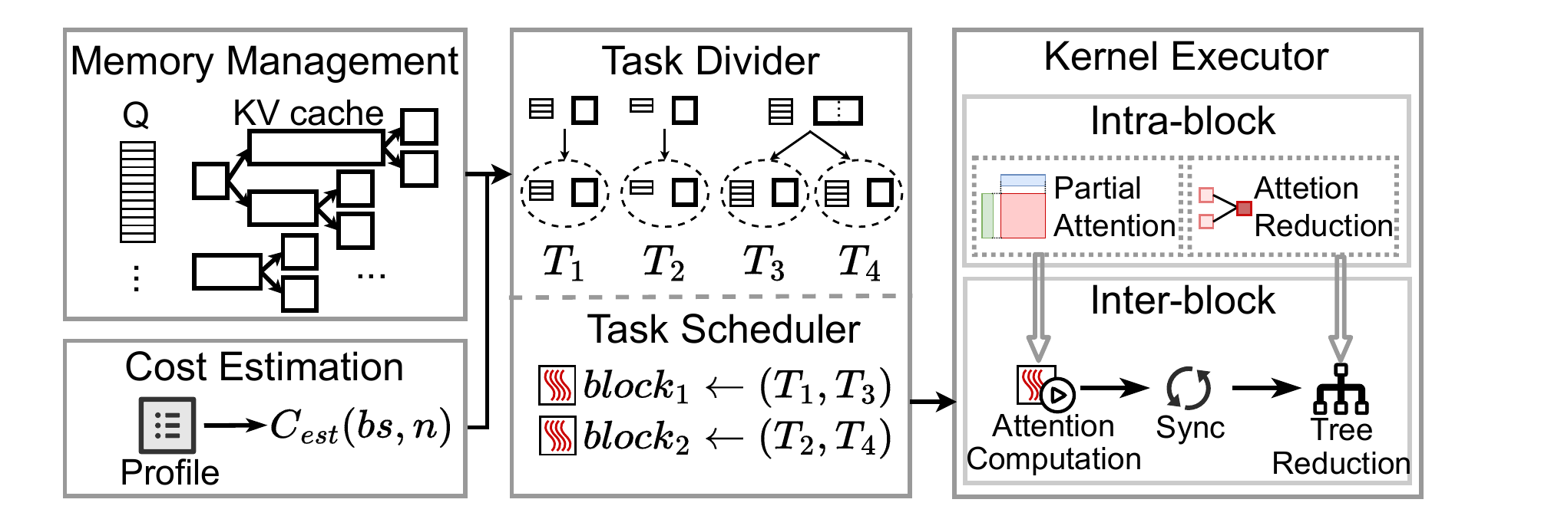
PAPER 07 · INFERENCE SERVING
SIGMOD'26
CoDec：Decode Attention 复用共享前缀
CoDec: Prefix-Shared Decoding Kernel for LLMs
MECHANISM
1.9× attention speedup
共享前缀 attention 路径复用
MEMORY
120.9× memory reduction
prefix-shared KV forest 降低重复访问
TAKEAWAY
3.8× TPOT improvement
共享前缀改变 decode 阶段执行路径
Source: local paper PDF · core figure cropped from paper
07

Slide 8
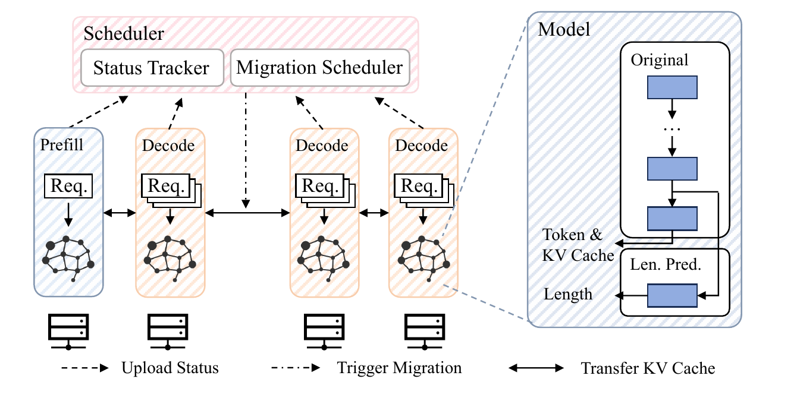
PAPER 08 · INFERENCE SERVING
HPDC'26
STAR：Decode 阶段重调度长输出请求
STAR: Decode-Phase Rescheduling for LLM Inference
CORE PROBLEM
长输出请求让 decode 实例负载持续漂移 静态分配会推高 TPOT 尾延迟与 KV cache OOM
SYSTEM IDEA
1. Predict remaining output length
2. Detect load drift during decode
3. Migrate request / KV cache
4. Rebalance serving instances
goodput 最高 2.63×；P99 TPOT 降低 75.1%
TAKEAWAY
调度必须把未来剩余生成长度纳入运行时负
载均衡。
Source: local paper PDF · core figure cropped from paper
08

Slide 9
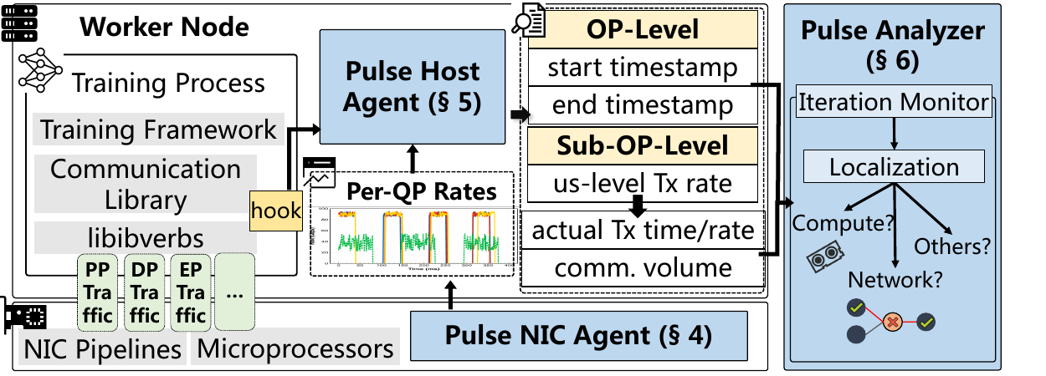
PAPER 09 · OBSERVABILITY & AIOPS
ASPLOS'26
Pulse：RNIC → Host Agent → Analyzer 定位训练异常
Fine-grained and Non-intrusive LLM Training Monitoring via Microsecond-level Traffic Measurement
RNIC / NIC Agent
per-QP 微秒级 RDMA 速率测量
Host Agent
hook NCCL / RDMA API，映射 collective P2P operator
Pulse Analyzer
12 类故障中 10 类机器级定位 100% NIC 流量可见
Source: local paper PDF · core figure cropped from paper
09

Slide 10
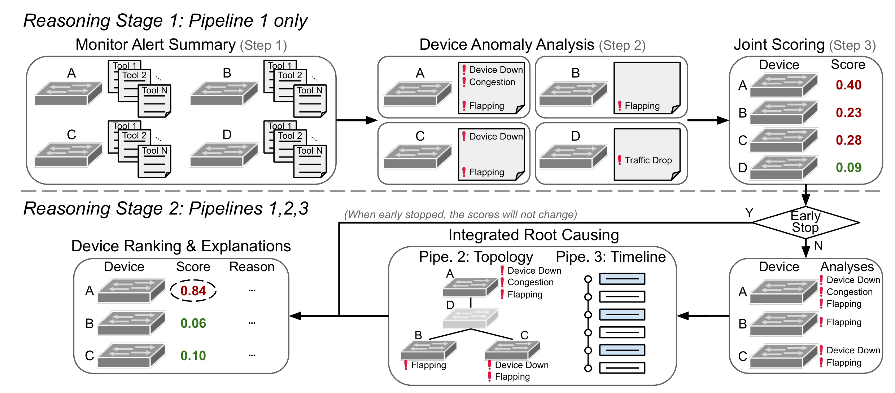
PAPER 10 · OBSERVABILITY & AIOPS
SIGCOMM'25
BiAn：LLM 编排生产网络故障定位推理
Towards LLM-Based Failure Localization in Production-Scale Networks
CORE PROBLEM
生产网络事故叠加告警、拓扑与时间依 赖，人工 root causing 慢且难覆盖 未知复杂事故。
SYSTEM IDEA
Monitor Alert Summary → Device Anomaly Analysis → Integrated Root Causing融合设备异常 网络拓扑与事件时间线，低延迟输出定 位结论。
· Top-1 accuracy 95.5%
· TTR -20.5%
TAKEAWAY
LLM 需要结构化、多阶段 低延迟流水线，才能上线辅助运维
Source: local paper PDF · core figure cropped from paper
10

Slide 11
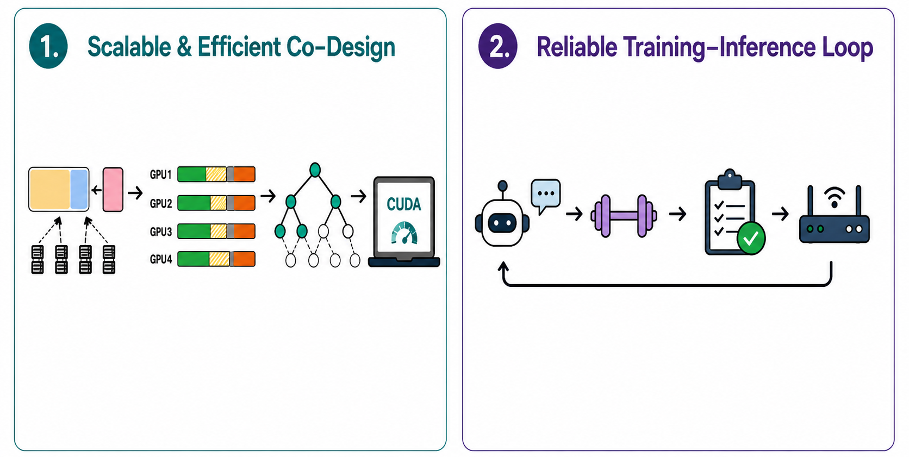
PAPER 11 · Future Works
Future Directions
Kernel Generate Agent
Efficient and Stable RL Infra
Extend to Domestic GPUs and NPUs
KV-Aware Routing
Prefix Merge Training
Closed-Loop Feedback
Train with Multi-Turn RL
Deterministic Execution
11
11

Slide 12
PAPER 12 · Transition
CoDec 与 STAR
CoDec 的 prefix-shared decode kernel 与 STAR 的 decode-phase rescheduling
01
训练系统优化
02
推理服务优化
03
可观测与 AIOps
04
未来工作
SIGMOD'26
CoDec
HPDC'26
STAR
SERVE
在线 LLM serving 与用户请求
Prefix-shared decode kernel
Decode-phase rescheduling
共享前缀仍反复读取 KV cache
长输出请求导致实例负载漂移
CORE PAIN
长上下文与长输出请求共同放大 decode 阶段负载;后续部分将分别从kernel reuse与runtime rescheduling 切入
复用前缀 attention，降低 memory traffic
预测剩余长度，运行时迁移重均衡
CAPABILITY
SYSTEM VIEW
先讨论 CoDec 如何减少重复 KV 读取 再讨论 STAR 如何预测剩余输出并迁
移重均衡
Kernel
Scheduler
Serving SLO
>
>
attention reuse
decode rebalance
latency / OOM
Source: transition into detailed CoDec and STAR sections
12

Slide 13



CoDec
Prefix-Shared Decoding Kernel for LLMs
Zhibin Wang¹, Rui Ning¹, Chao Fang¹, Zhonghui Zhang¹, Xi Lin¹, Shaobo Ma¹, Mo Zhou¹, Xue Li², Zhongfeng Wang¹, Chengying Huan¹, Rong Gu¹, Kun Yang¹, Guihai Chen¹, Sheng Zhong¹, Chen Tian¹
Before
x4 reads
CoDec
x1 read
Q1
Q1
1 State Key Laboratory for Novel Software Technology, Nanjing University, China
^{2 Alibaba Group, China}
Q2
Q2
x4
x1
Q3
Q3
KV
SIGMOD'26 Bengaluru, India, on May 31 - June 05, 2026.
Q4
Q4
13

Slide 14

Outline
01
Motivation
Long-context serving, prefix sharing, and decode memory bottlenecks
02
Insight & Challenges
Shared-prefix reuse, dependency organization, and load balancing
03
CoDec Design
Prefix-tree planning, task division, and attention kernel
04
Evaluation & Takeaways
Throughput gains, ablations, and applicability
Guiding Question
Why does prefix sharing matter, and why does decode attention become the bottleneck?
CoDec | SIGMOD Research Talk
14

Slide 15
LLM Serving Trends
BACKGROUND
Trend 1: Context length increases.
Retriever
KV Cache
1M+ tokens
Prompt
User Conversation
Output
Trend 2: Attention dominates computation.
CoDec | SIGMOD Research Talk
15
Notes:
So let me start from two observations on LLM serving trends nowadays:
First, context length is increasing dramatically.
Modern agentic systems may involve extremely long contexts, especially when those requests are combined with retrieval and multi-turn conversations.
Second, as context length grows, attention layer increasingly dominates computation, becoming the main bottleneck in LLM serving.
And in the above serving trends, prefix sharing workloads are becoming increasingly common.

Slide 16
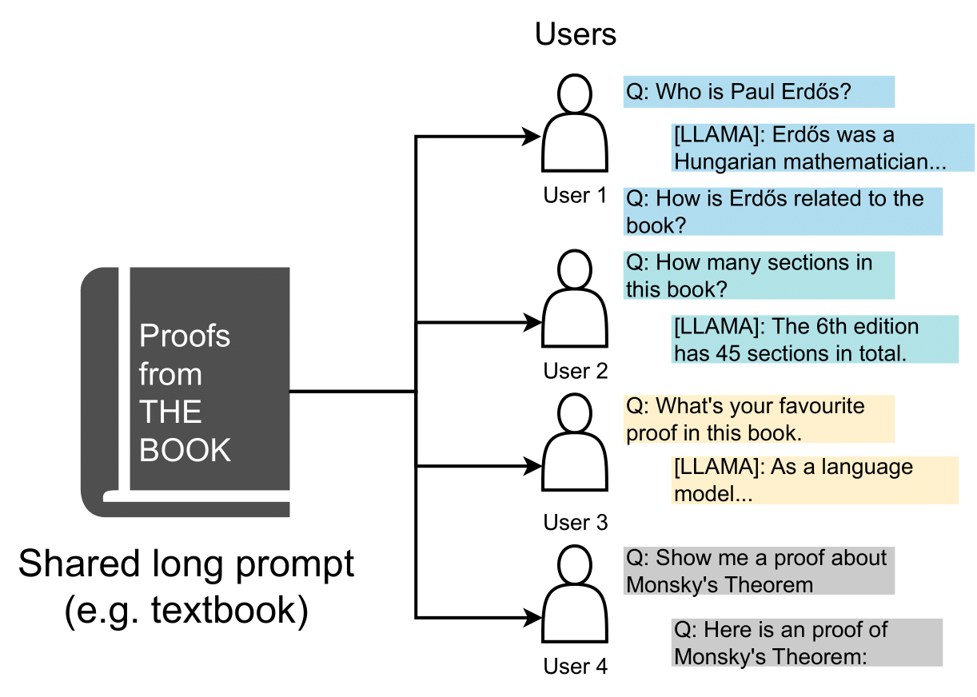
Prefix Sharing Workloads
MOTIVATION
Many long-context workloads share large common prefixes.
Workload | Avg. Prompt | Prefix Sharing Rate
LooGLE [1] | 23,474 | 91%
ToolBench [2] | 1,835 | 85%
NExT-QA [3] | 9,865 | 88%
[1] Jiaqi, Li, et al. “Can Long-Context Language Models Understand Long Contexts?” ACL 2024.
[2] Yujia, Qin, et al. “Towards Stage Large-Scale Benchmarking on Tool Learning of Large Language Models” ACL 2024.
[3] Junbin, Xiao, et al. “Next Phase of Question-Answering to Explaining Temporal Actions” CVPR 2021.
CoDec | SIGMOD Research Talk
16
Notes:
And before we dive into, we need to answer one question first.
Why is prefix sharing workload so important among all those long-context workloads?
Here I quote 3 typical long-context datasets from top-tier machine learning conferences.
You can see that the prefix sharing rate here is extremely high and can even achieve 90% in some scenarios.
And in many real-world LLM serving scenarios, requests are also not independent—they often share a proportion of prefix tokens.
Such workloads are very popular in cases like multi-turn chat or tree-of-thought reasoning.

Slide 17
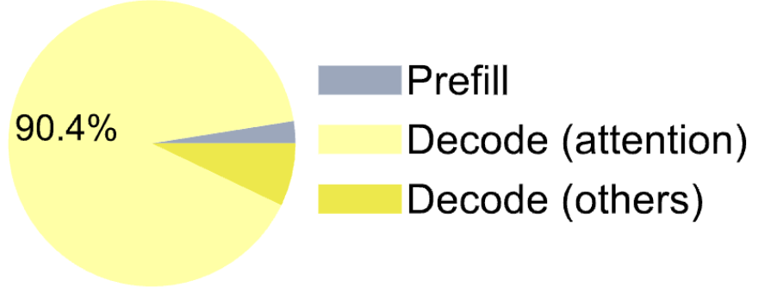

Prefix Sharing Workloads: Prefill Stage
MOTIVATION
Decode attention dominates runtime.
In prefill stage, KV cache can be shared to reduce computation.
“What day is it today”
“What day is it tomorrow”
Prefill for Request 1
Prefill for Request 2
Model: Llama-3.1-8B
Input length: 100K prompt tokens
Output length: 128 tokens
What
What
What
What
day
day
day
day
KV Cache Reuse
is
is
is
is
We always decode 1 token/request.
Can we still reuse KV cache in decode stage?
it
it
it
it
today
today
tomorrow
tomorrow
(5 tokens computed)
(1 token computed)
CoDec | SIGMOD Research Talk
17
Notes:
And actually, the researchers have done a lot of work about KV cache reuse in this field to solve this problem. During the prefill stage, it’s common to share KV cache to reduce redundant computation across request.
For example, here, suppose the user first send request 1, with content "What day is it today". Then in the prefill stage, the KV cache for all these five tokens will be computed.
And then, suppose the user send the following request 2, with content "What day is it tomorrow". Then with the KV cache reuse enabled, the KV cache for the first 4 tokens won't need to be computed again. We only need to compute the KV cache for the last token "tomorrow".
So the number of tokens we need to compute reduced from 5 tokens to 1 token.
Existing solutions like Radix Attention and Paged Attention or LMCache already did this work well at prefill stage.
However, in decode stage, this problem is under-explored.
The main problem is that when serving typical autoregressive model, we compute one token per request in decode stage.
It seems that we cannot further reduce computations use similar techniques from prefill stage.
Can we still reuse KV cache in decode stage?

Slide 18
Prefix Sharing Workloads: Decode Stage
MOTIVATION
Red bars denote thread blocks on GPU
Rectangles denote KV cache
Document A
Document B
Question 1
Next Token
Document A
Document B
Question 2
Next Token
Document A
Document C
Question 3
Next Token
Document A
Document C
Question 4
Next Token
3x more memory accesses to Document A’s KV cache
CoDec | SIGMOD Research Talk
18
Notes:
To answer this question, we need to further look at the attention mechanism on GPU.
Here we use an example of 4 requests in decode stage.
And in the figure, the red bars denote thread blocks on GPU while rectangles denote KV cache.
In traditional attention kernel like Flash Attention, we assign each request to a thread block on GPU.
And then, each thread block accesses the KV cache of the corresponding request and compute the output.
The naive execution leads to multiple thread blocks repeatedly loading the same KV cache,
You can see the grey areas in the figure.
causing, for example, 3× more memory accesses to Document A’s KV cache.

Slide 19
Outline
01
Motivation
Long-context serving, prefix sharing, and decode memory bottlenecks
02
Insight & Challenges
Shared-prefix reuse, dependency organization, and load balancing
03
CoDec Design
Prefix-tree planning, task division, and attention kernel
04
Evaluation & Takeaways
Throughput gains, ablations, and applicability
Guiding Question
If prefixes are shared, how can we read KV cache once without breaking dependencies?
CoDec | SIGMOD Research Talk
19

Slide 20
Our Insight
INSIGHT
Organize KV cache into prefix tree and combine memory access.
Question 1
Document B
Question 2
Document A
× 4
→
Document A
× 1
Document A
Document B
× 2
→
Document B
× 1
Question 3
Document C
× 2
→
Document C
× 1
Document C
Question 4
CoDec | SIGMOD Research Talk
20
Notes:
However, once we turned the requests into a prefix tree, the first challenge is how can we organize dependencies across the prefix tree and across GPU thread blocks.
Our solution here is to divide the whole attention computing mechanisms into two stages.
In stage 1, we assign each prefix part to a dedicated thread block as the red bar denoted in the figure.
So you can see that, in the first stage, those thread blocks on GPU will read the KV cache and compute the partial output. And those partial output can be reused across different requests, further reduce computation.
And this is exactly the difference between us and other solutions like LMCache, we reuse the partial output from KV cache, while LMCache reuse KV cache directly.

Slide 21
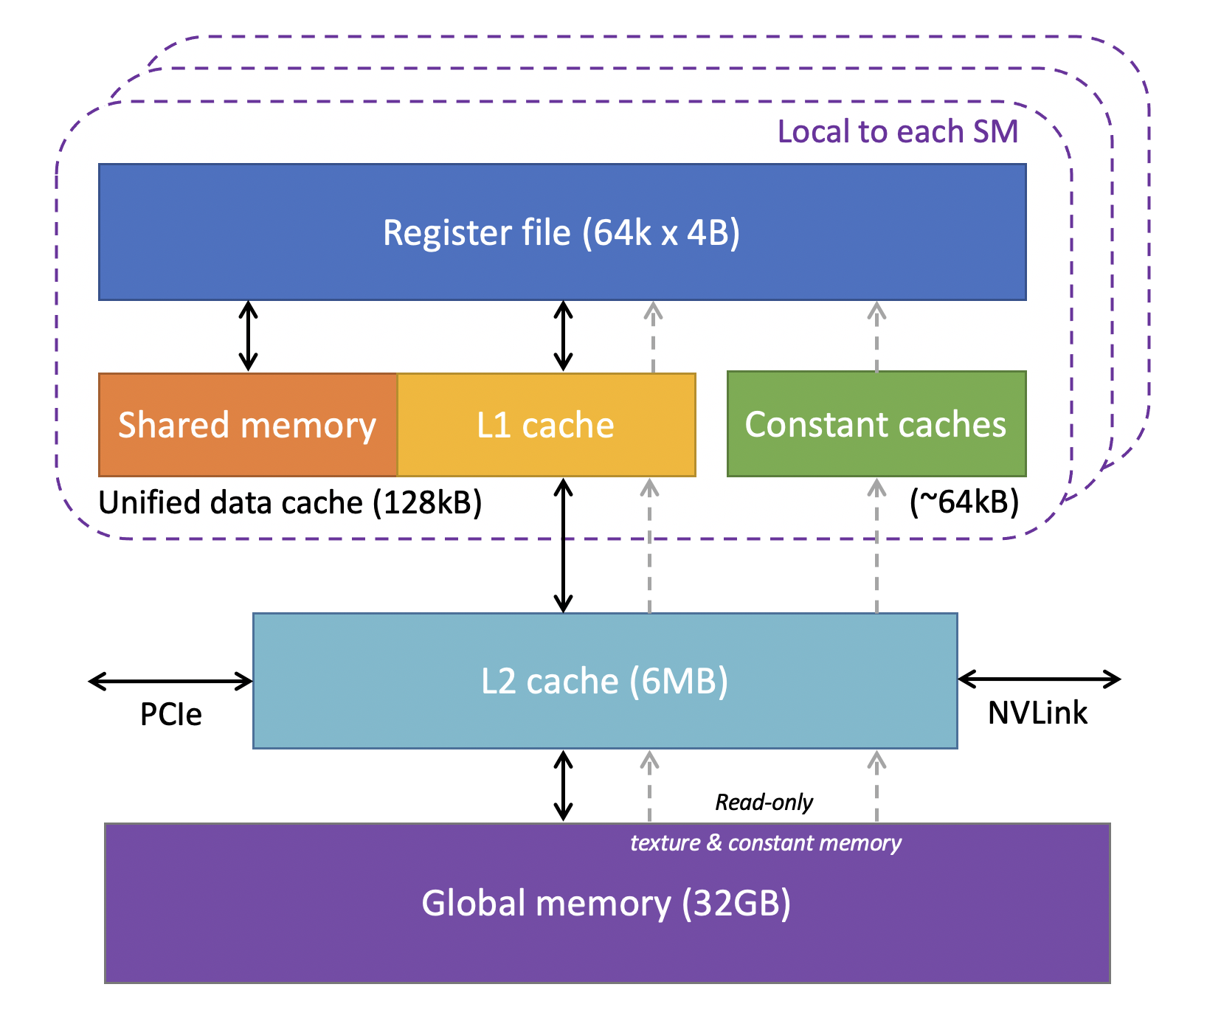
Our Insight
INSIGHT
Organize KV cache into prefix tree and combine memory access.
Question 1
Document B
Question 2
Document A
Question 3
Document C
Question 4
KV Cache
Document A
Document B
Document C
Question 1
Question 2
Question 3
Doc
Question 4
CoDec | SIGMOD Research Talk
21
Notes:
However, once we turned the requests into a prefix tree, the first challenge is how can we organize dependencies across the prefix tree and across GPU thread blocks.
Our solution here is to divide the whole attention computing mechanisms into two stages.
In stage 1, we assign each prefix part to a dedicated thread block as the red bar denoted in the figure.
So you can see that, in the first stage, those threadblocks on GPU will read the KV cache and compute the partial output. And those partial output can be reused across different requests, further reduce computation.
And this is exactly the difference between us and other solutions like LMCache, we reuse the partial output from KV cache, while LMCache reuse KV cache directly.

Slide 22
Challenge: Organize Dependency
CHALLENGE
Decode attention requires careful dependency management.
Red bars denote thread blocks on GPU
Rectangles denote KV cache
Document A
Document B
Question 1
Out₁
⊕
Out_{B}
⊕
Out_{A}
Document A
Document B
Question 2
Out₂
⊕
Out_{B}
⊕
Out_{A}
Document A
Document C
Question 3
Out₃
⊕
Out_{C}
⊕
Out_{A}
Document A
Document C
Question 4
Out₄
⊕
Out_{C}
⊕
Out_{A}
CoDec | SIGMOD Research Talk
22
Notes:
So, to implement our insight, we need to form a prefix tree out of previous requests.

Slide 23
Challenge: Organize Dependency
CHALLENGE
Red bars denote thread blocks on GPU
Rectangles denote KV cache
Question 1
Out₁
Document B
Out_{B}
Question 2
Out₂
Document A
Out_{A}
Question 3
Out₃
Document C
Out_{C}
Question 4
Out₄
Stage 1: Compute Partial Output
CoDec | SIGMOD Research Talk
23
Notes:
However, once we turned the requests into a prefix tree, the first challenge is how can we organize dependencies across the prefix tree and across GPU thread blocks.
Our solution here is to divide the whole attention computing mechanisms into two stages.
In stage 1, we assign each prefix part to a dedicated thread block as the red bar denoted in the figure.
So you can see that, in the first stage, those threadblocks on GPU will read the KV cache and compute the partial output. And those partial output can be reused across different requests, further reduce computation.
And this is exactly the difference between us and other solutions like LMCache, we reuse the partial output from KV cache, while LMCache reuse KV cache directly.

Slide 24
Challenge: Organize Dependency
CHALLENGE
Red bars denote thread blocks on GPU
Rectangles denote KV cache
Question 1
Out₁
Document B
Out_{B}
Question 2
Out₂
Document A
Out_{A}
Question 3
Out₃
Document C
Out_{C}
Question 4
Out₄
Stage 2: Reduce Partial Outputs
CoDec | SIGMOD Research Talk
24
Notes:
And then comes to the second part, after we acquired those partial outputs, we need to reduce those outputs.
In stage 2, we reduce those outputs layer by layer.

Slide 25
Challenge: Organize Dependency
CHALLENGE
Red bars denote thread blocks on GPU
Rectangles denote KV cache
Question 1
Out₁
Document B
Out_{B}
⊕
Out_{A}
Question 2
Out₂
Document A
Question 3
Out₃
Document C
Out_{C}
⊕
Out_{A}
Question 4
Out₄
Stage 2: Reduce Partial Outputs
CoDec | SIGMOD Research Talk
25

Slide 26
Challenge: Organize Dependency
CHALLENGE
Red bars denote thread blocks on GPU
Rectangles denote KV cache
Question 1
Out₁
⊕
Out_{B}
⊕
Out_{A}
Document B
Question 2
Out₂
⊕
Out_{B}
⊕
Out_{A}
Document A
Question 3
Out₃
⊕
Out_{C}
⊕
Out_{A}
Document C
Question 4
Out₄
⊕
Out_{C}
⊕
Out_{A}
Stage 2: Reduce Partial Outputs
CoDec | SIGMOD Research Talk
26

Slide 27
Challenge: Organize Dependency
CHALLENGE
Red bars denote thread blocks on GPU
Rectangles denote KV cache
Question 1
Next Token
Document B
Question 2
Next Token
Document A
Question 3
Next Token
Document C
Question 4
Next Token
Stage 2: Reduce Partial Outputs
CoDec | SIGMOD Research Talk
27

Slide 28
Challenge: Workload Imbalance
CHALLENGE
Requests
KV Cache
GPU SMs
Welcome to our computer support system. Here we handle a wide range of computer-related issues.
Whether it's about software, hardware, networking or data management, we'll provide you with the necessary guidance...
Document
How can I remove this app? Q1
Here are basic rules and ways for various software issues... Q2
My laptop battery is draining very fast. What's wrong with it? Q3
Busy!
Free!
How to install my app. Q4
Regarding runtime failures, I can...
Q5
CoDec | SIGMOD Research Talk
28
Notes:
However, there still exists one problem, which is workload imbalance.
We assume all those documents are equally long in previous setup.
And if you consider the example here, you can see that the document is a lot longer than the questions.
If tasks are assigned naively, some GPU SMs can be free while others are busy, leading to severe tail effects; Instead, we want a balanced schedule across SMs.

Slide 29
Challenge: Workload Imbalance
CHALLENGE
Requests
KV Cache
GPU SMs
Welcome to our computer support system. Here we handle a wide range of computer-related issues.
Whether it's about software, hardware, networking or data management, we'll provide you with the necessary guidance...
Document
How can I remove this app? Q1
Here are basic rules and ways for various software issues... Q2
My laptop battery is draining very fast. What's wrong with it? Q3
Balanced!
How to install my app. Q4
Regarding runtime failures, I can...
Q5
CoDec | SIGMOD Research Talk
29
Notes:
We designed a task partition algorithm to partition long workloads into smaller ones and distribute them onto different thread blocks.
This way, we’ll not only have a more balanced workload distribution but also a higher SM occupancy on GPU.

Slide 30
Outline
01
Motivation
Long-context serving, prefix sharing, and decode memory bottlenecks
02
Insight & Challenges
Shared-prefix reuse, dependency organization, and load balancing
03
CoDec Design
Prefix-tree planning, task division, and attention kernel
04
Evaluation & Takeaways
Throughput gains, ablations, and applicability
Guiding Question
How does CoDec turn a prefix tree into balanced GPU attention work?
CoDec | SIGMOD Research Talk
30

Slide 31
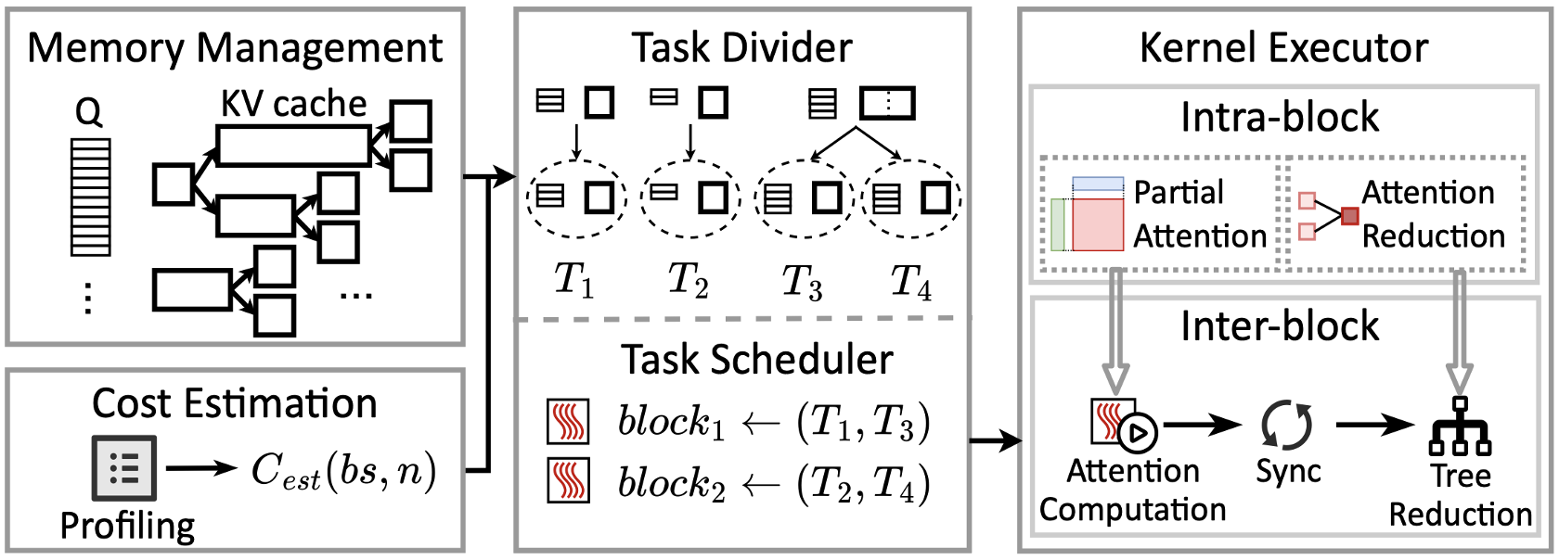
CoDec: Efficient Prefix-Aware Attention
CODEC DESIGN
Organize Prefix Tree
CoDec | SIGMOD Research Talk
31
Notes:
Putting all these together, we got the whole workflow of Codec.
In the first step, we organize a batch of requests into a prefix tree.

Slide 32
CoDec: Efficient Prefix-Aware Attention
CODEC DESIGN
Divide Compute Tasks
CoDec | SIGMOD Research Talk
32
Notes:
And then, we divide compute tasks and assign them to different thread blocks on GPU.

Slide 33
CoDec: Efficient Prefix-Aware Attention
CODEC DESIGN
Execute Attention Kernel
CoDec | SIGMOD Research Talk
33
Notes:
Finally, after all the metadata needed are prepared.
We can execute the attention kernel on GPU.

Slide 34
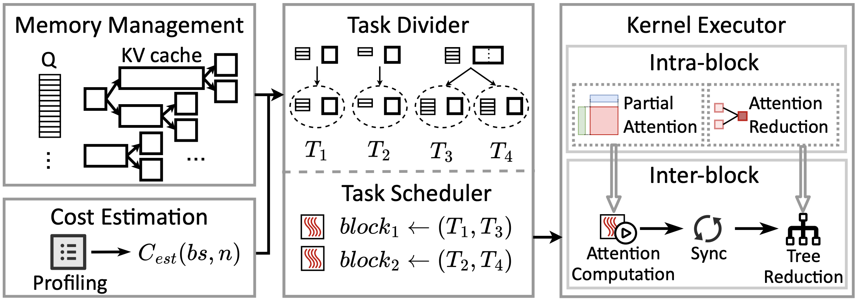
CoDec: Efficient Prefix-Aware Attention
CODEC DESIGN
CoDec | SIGMOD Research Talk
34
Notes:
This is the whole workflow of FlashForge.

Slide 35
Outline
01
Motivation
Long-context serving, prefix sharing, and decode memory bottlenecks
02
Insight & Challenges
Shared-prefix reuse, dependency organization, and load balancing
03
CoDec Design
Prefix-tree planning, task division, and attention kernel
04
Evaluation & Takeaways
Throughput gains, ablations, and applicability
Guiding Question
Does CoDec deliver real throughput gains, and where do those gains come from?
CoDec | SIGMOD Research Talk
35

Slide 36
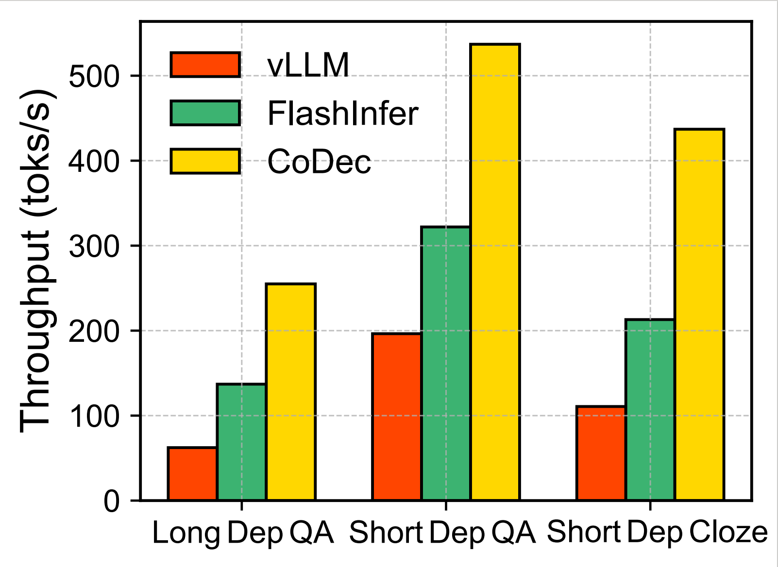
Evaluation
EVALUATION
Implemented CoDec in vLLM using NVIDIA CuTe. (~1.7k LOCs)
Achieves up to 3.75x throughput speedup over vLLM.
Total: 10.84×
2.28×
2.81×
1.69×
CoDec | SIGMOD Research Talk
36
Notes:
The evaluation shows that we achieves up to 2.9x throughput speedup on vLLM.
And the ablation study also shows the effectiveness of our task division algorithm to mitigate workload imbalance.
Any questions here?
This techniques can also be used in semi-AR dllm. You can just see those KV blocks as the prefix node in the prefix tree.

Slide 37
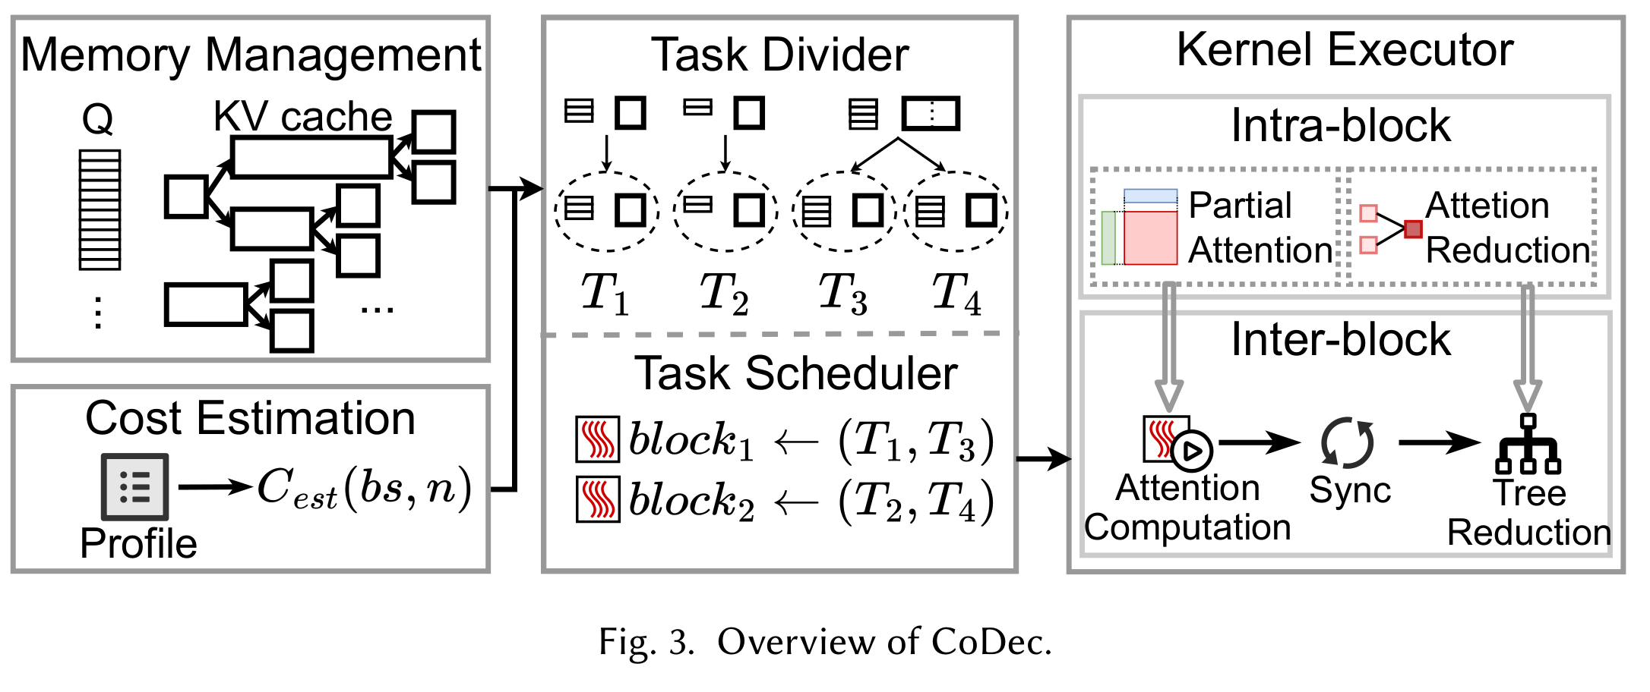
TAKEAWAYS
Takeaways
01
Decode bottleneck
Prefix reuse saves prefill, but decode still rereads shared KV.
02
Tree-aware attention
CoDec coalesces KV reads and reduces outputs over prefix trees.
03
IO-driven speedup
120.9x less memory traffic, 3.75x lower TPOT.
CoDec | SIGMOD Research Talk
37

Slide 38
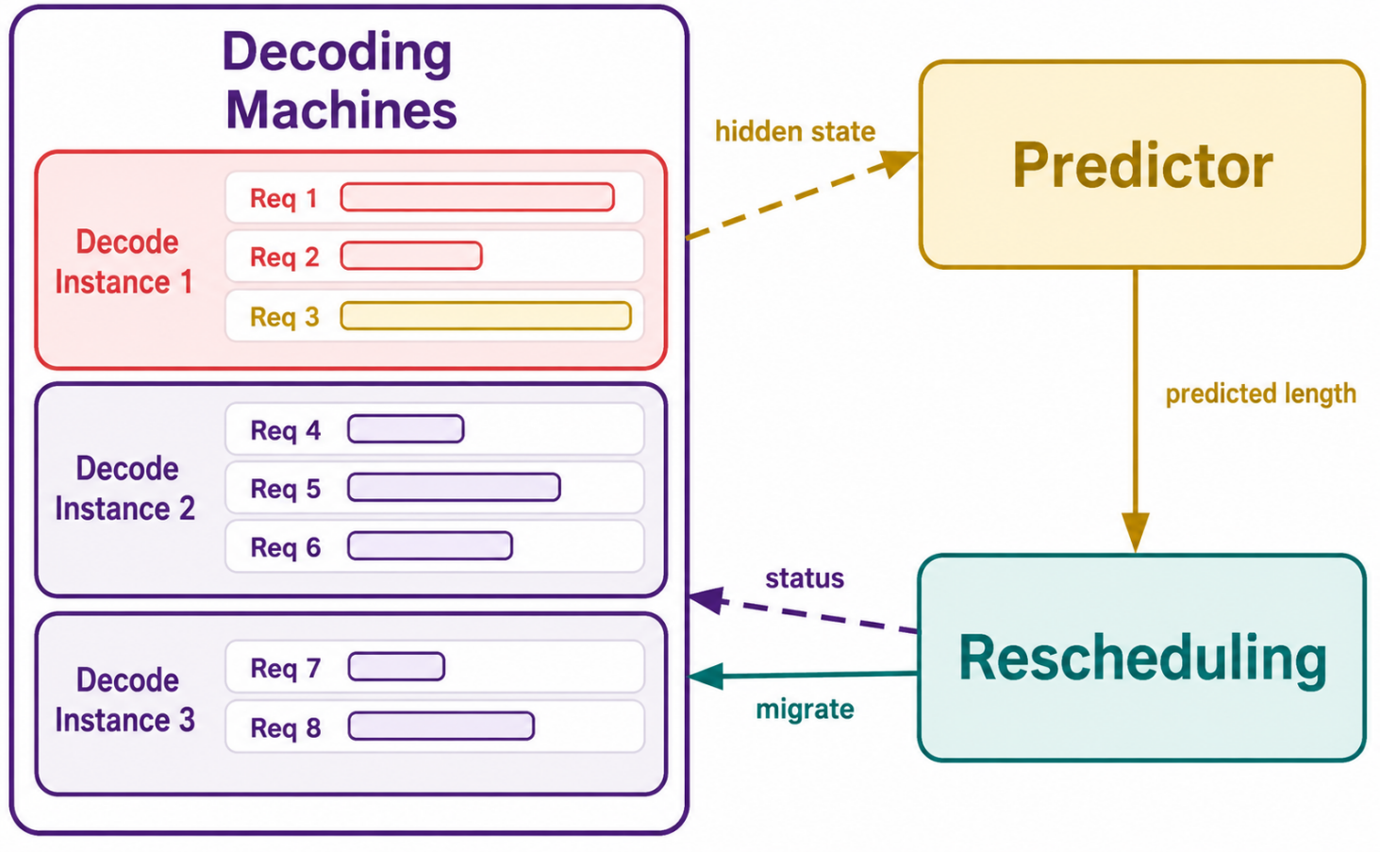
STAR
Decode-Phase Rescheduling
for LLM Inference
Zhibin Wang, Zetao Hong, Xue Li, Zibo Wang,
Shipeng Li, Qingkai Meng, Qing Wang,
Chengying Huan, Rong Gu, Sheng Zhong, Chen Tian
State Key Laboratory for Novel Software Technology,
Nanjing University
Alibaba Group
HPDC '26 | July 13-16, 2026 | Cleveland, OH, USA
38

Slide 39
Outline
01
Motivation
Why does long-output serving break static handoff?
02
Design
How can STAR predict and rebalance decode work?
03
Evaluation
Does STAR improve goodput, tail TPOT, and reliability?
04
Takeaways
What should serving systems remember from STAR?
CURRENT SESSION
Why does long-output serving need decode-phase rescheduling?
STAR: Decode-Phase Rescheduling for LLM Inference
39

Slide 40
BACKGROUND
Long outputs shift bottleneck to decode.
LLM inference pipeline
Request
->
Prefill
->
Decode
->
Response
prompt arrives
one forward pass
compute-bound
token by token
memory-bound
completed output
Long reasoning outputs keep requests resident in decode phase.
ARCHITECTURE
SCHEDULING GAP
PD disaggregation separates phases
Static handoff must last too long
PD systems split prefill and decode to avoid interference.
Initial placement must survive thousands of decode steps.
Implication: static handoff must remain valid across thousands of token steps.
STAR: Decode-Phase Rescheduling for LLM Inference
40

Slide 41
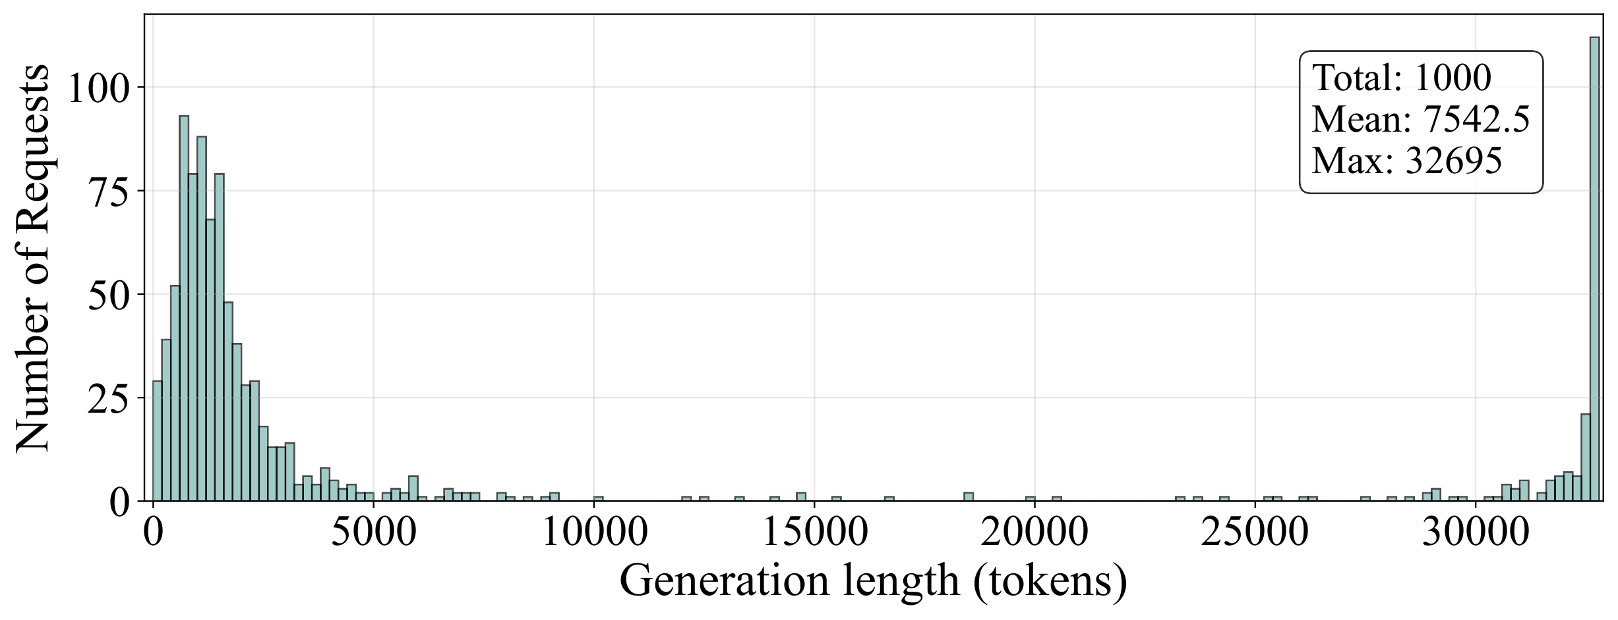
MOTIVATION
Static decode assignment causes imbalance.
29.2%
short outputs
Generate fewer than 1K tokens.
17.3%
very long outputs
Exceed 30K tokens and dominate
residency.
>16x
real request variation
ShareGPT output-length distribution with DeepSeek-R1-Distill-Qwen-7B
Gemini example pairs differ by more than sixteen times.
Quantile
Output length (The Decode Workload)
Long requests keep accumulating KV cache after handoff.
P50
1,536 tokens
P90
32,670 tokens
P95
32,679 tokens
STAR: Decode-Phase Rescheduling for LLM Inference
41

Slide 42
OBSERVATION
Imbalance workload in decode phase.
KV cache capacity:18
request per second:1
prefill->decode: select lowest kv cache load instance
decode
instance1
req1
req1
req1
req1
req2
req2
req2
req2
OOM
req3
req3
req3
req3
decode
instance2
req4
req4
req4
req4
req5
req5
req5
req5
req6
finish
req10
finish
decode
instance3
req7
req7
finish
req11
finish
req12
req8
req8
finish
req9
req9
req9
req9
T
T+1
T+1
T+3
req6 finish
schedule req10 to instance2
req7 finish
req8 finish
req10 finish
schedule req11 to instance3
req11 finish
schedule req12 to instance3
instance1 oom
Long requests on the same node keep growing KV cache, causing imbalance.
STAR: Decode-Phase Rescheduling for LLM Inference
42

Slide 43
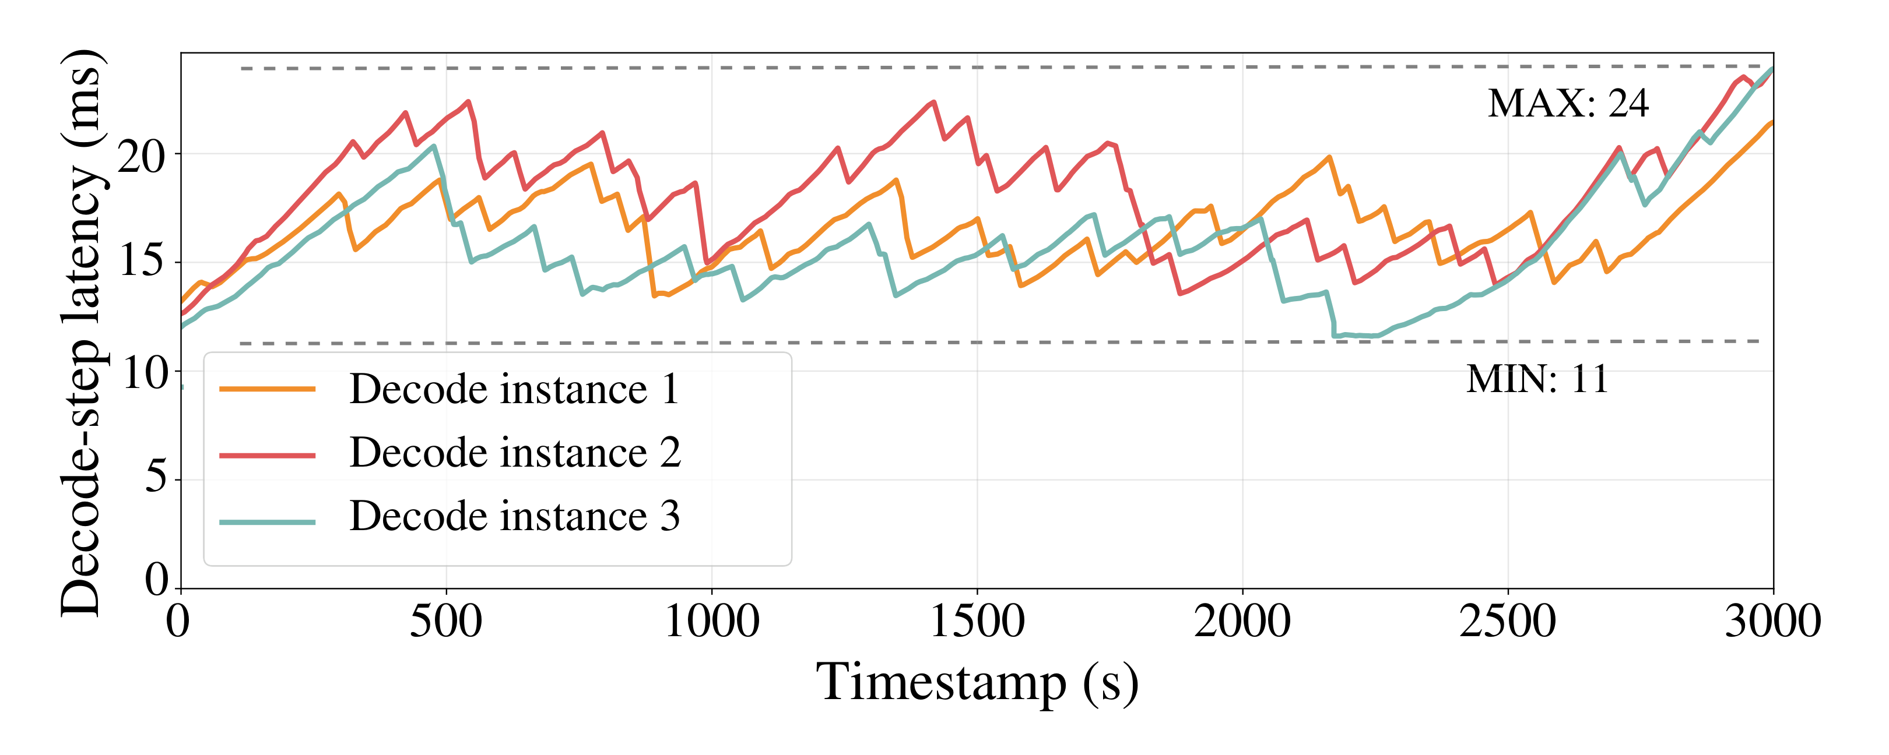
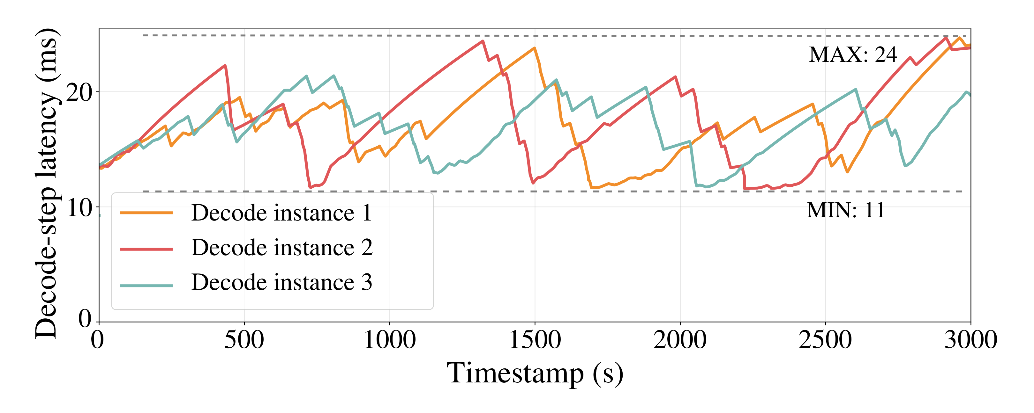
OBSERVATION
Imbalance workload in decode phase.
Round-robin scheduling: per-instance TPOT diverges
Current-load balancing: still drifts as sequences evolve
Decode-step latency is roughly proportional to the kvcache usage of the instance.
1
KV-cache OOM
2
SLO violations
3
Missing runtime control
Long outputs pile up, trigger OOM, and cause cascading recomputation.
Saturated instances create tail-latency spikes as outputs grow.
PD schedulers assign once and miss future decode load.
STAR: Decode-Phase Rescheduling for LLM Inference
43

Slide 44
RESEARCH PROBLEM
Decode rescheduling needs foresight.
Goal
Keep decode load balanced with timely, low-cost, memory-safe migrations.
C1: Predict remaining length online
STAR
C2: Migrate what / when / where
Prompt-only predictors are intrusive, weak for long context, or too costly.
foresight
safe migration
Migration must reduce future imbalance
without causing OOM.
Design principle
Prediction only matters when it becomes a safe migration decision.
STAR: Decode-Phase Rescheduling for LLM Inference
44
Notes:
Removed design principle:
Prediction is useful only if the scheduler converts it into low-overhead, memory-safe migration decisions.
Detailed challenge context: prompt-only predictors may be intrusive, weak for long context, or too costly; migration must reduce future imbalance without triggering OOM.

Slide 45
Outline
01
Motivation
Why does long-output serving break static handoff?
02
Design
How can STAR predict and rebalance decode work?
03
Evaluation
Does STAR improve goodput, tail TPOT, and reliability?
04
Takeaways
What should serving systems remember from STAR?
CURRENT SESSION
How does STAR turn prediction into safe decode migration?
STAR: Decode-Phase Rescheduling for LLM Inference
45

Slide 46
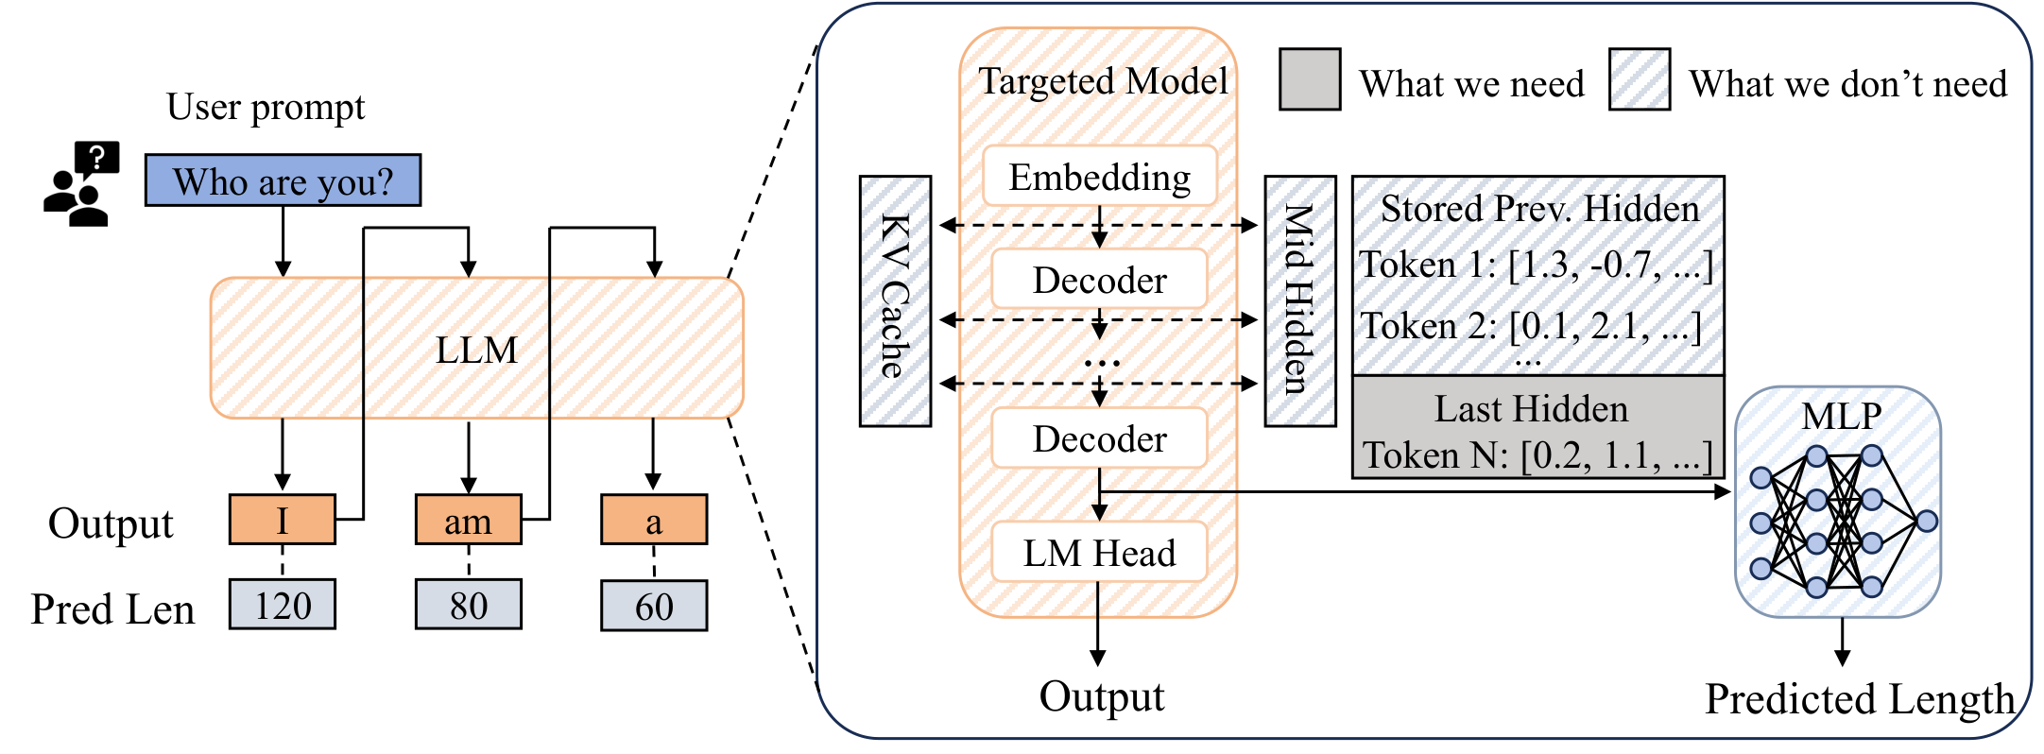
COMPONENT 1
Hidden states predict output length.
Eagle^{[1]} use hidden states to do speculative decoding.
Our idea: use hidden states to predictit output length.
Choice
Rationale
Hidden state
Integrated semantic context
Final layer
Abstract task trajectory
Last token
Fixed size; already available
Continuous
Prediction improves during decode
Runtime predictor: last-token final-layer hidden state -> 4-layer MLP
Why not prior predictors?
1
Prompt-based prediction
2
Auxiliary models
Requires user prompt modification and may change model behavior.
Use weaker context representations and degrade on long-output requests.
[1] Yuhui Li, Fangyun Wei, Chao Zhang, and Hongyang Zhang. 2025. EAGLE: Speculative Sampling Requires Rethinking Feature Uncertainty.
STAR: Decode-Phase Rescheduling for LLM Inference
46

Slide 47
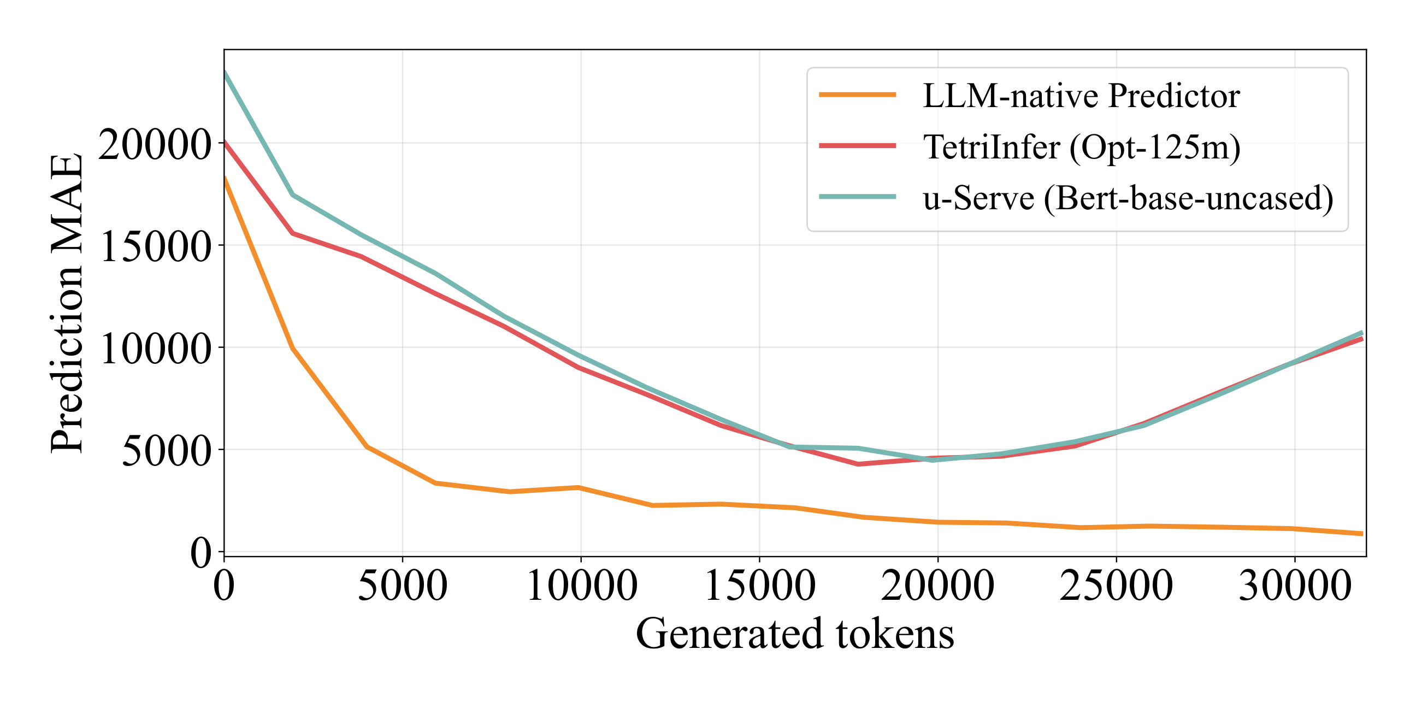
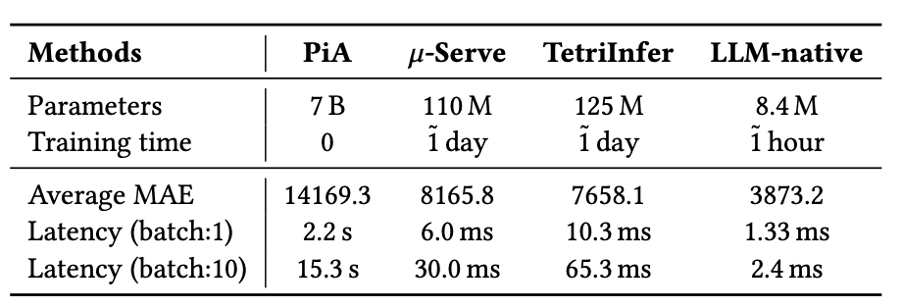
PREDICTION RESULTS
LLM-native prediction is accurate and cheap.
49.4%
96.3%
93.3%
lower MAE
lower latency
fewer params
Compared with the best auxiliary-model baseline
Low overhead for online reprediction
Only 8.4M predictor parameters
Continuous prediction improves as generated context accumulates
For 30-32K outputs, STAR's MAE keeps dropping as generation proceeds.
At the beginning of generation, the prediction error is large, but we can smooth it out. When the request is about to be completed, the prediction is very accurate.
STAR: Decode-Phase Rescheduling for LLM Inference
47

Slide 48
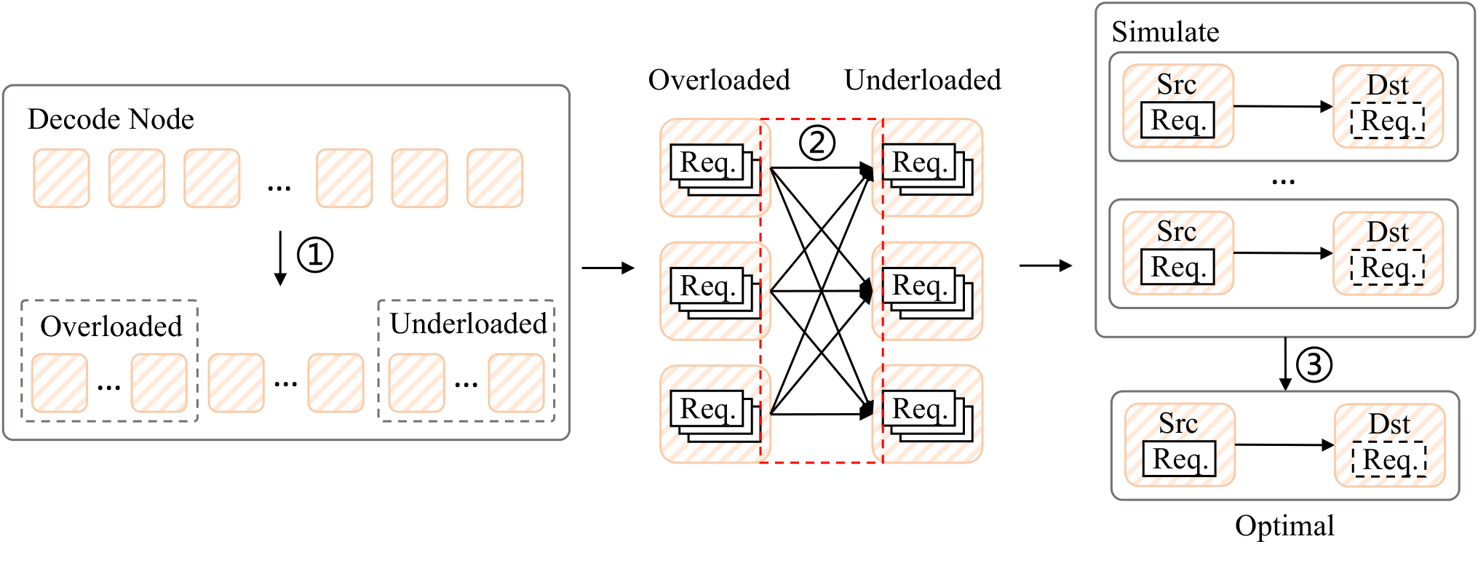
COMPONENT 2
Rescheduling balances predicted load.
Objective
Minimize time-weighted variance
of token loads
Combines current load with predicted remaining work.
Decode rescheduling workflow
Simulate future load based on current load and prediction information,
aiming to achieve the most balanced load in the future.
1
Classify instances
2
Enumerate candidates
3
Select best migration
Find overloaded and underloaded instances
Filter migrations that still pay off after transfer cost.
Choose the migration with the largest variance reduction.
STAR: Decode-Phase Rescheduling for LLM Inference
48

Slide 49
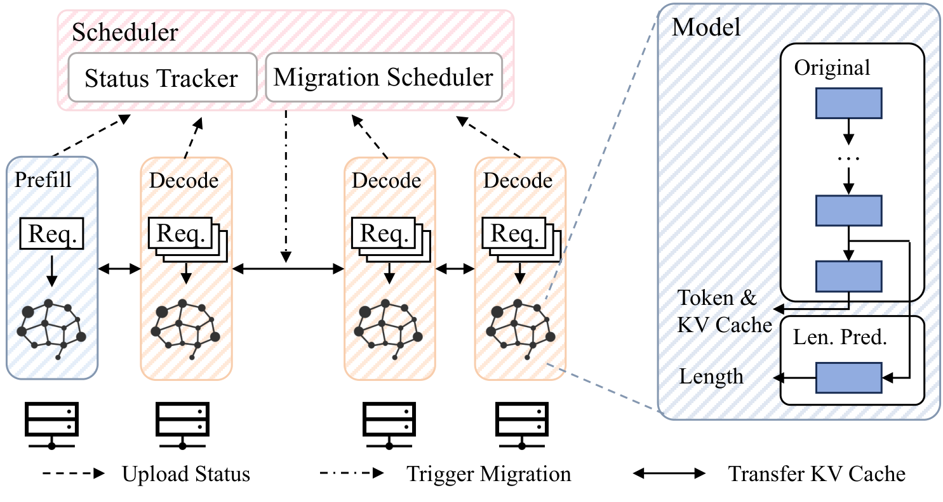
OVERVIEW
STAR unifies prediction and migration.
1.Continuous Prediction
Estimate each active request's remaining output length during decode.
Other optimizations.
Workers report current tokens, pre-computed future-load summaries, and memory pressure to reduce time complexity of the scheduler.
2.Decode Migration
STAR on top of PD-disaggregated inference
Move selected requests from overloaded to underloaded instances.
STAR migrates based on predicted remaining decode work.
STAR: Decode-Phase Rescheduling for LLM Inference
49

Slide 50
Outline
01
Motivation
Why does long-output serving break static handoff?
02
Design
How can STAR predict and rebalance decode work?
03
Evaluation
Does STAR improve goodput, tail TPOT, and reliability?
04
Takeaways
What should serving systems remember from STAR?
CURRENT SESSION
Does prediction-driven rescheduling pay off end to end?
STAR: Decode-Phase Rescheduling for LLM Inference
50

Slide 51
EVALUATION SETUP
Setup isolates rescheduling and prediction.
Measured outcomes
Setting
Small cluster
Large cluster
METRIC
GPU
4x RTX 4090D
8x H800
Goodput
Request throughput that satisfy the SLO.
Breakdown
1P + 3D
2P + 6D
Models
DeepSeek-R1-Distill-Qwen-7B
7B + Qwen3-14B
METRIC
P99 TPOT
Baselines
vLLM(industry-standard serving framework);
STAR w/o prediction; STAR w/ prediction; STAR Oracle
Tail latency of decode, where imbalance most directly appears.
SLO
TTFT < 1s, TPOT < 25ms
TTFT < 1s, TPOT < 50ms
METRIC
OOM behavior
Baselines isolate runtime rescheduling and prediction gains.
KV-cache saturation trace under long outputs.
STAR: Decode-Phase Rescheduling for LLM Inference
51

Slide 52
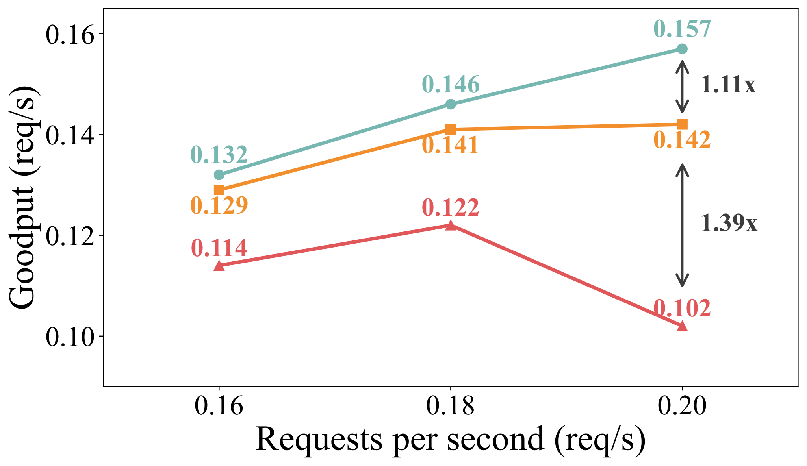
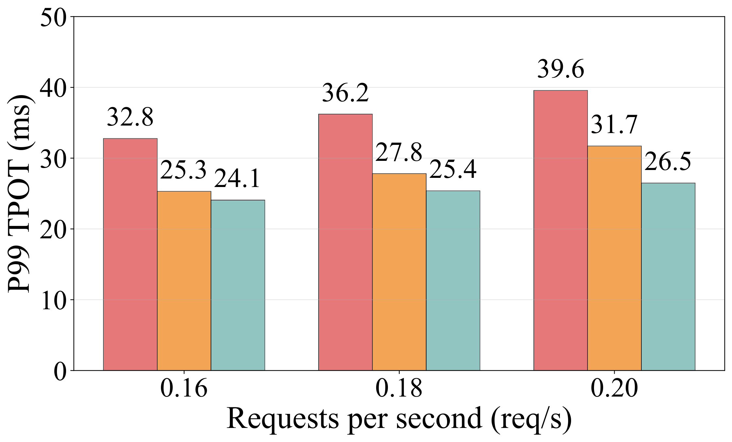
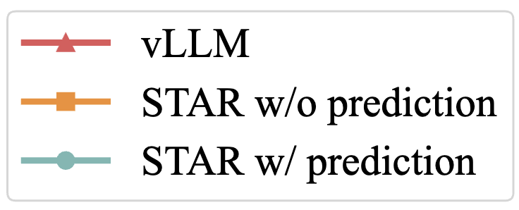
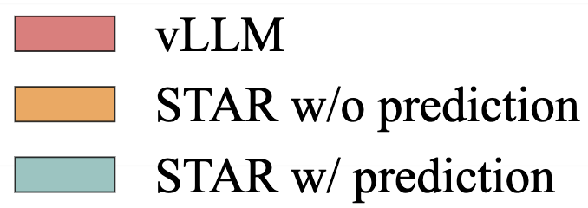
END-TO-END RESULTS
STAR boosts goodput and cuts tail TPOT.
Goodput on ShareGPT, 8 * H800
P99 TPOT on ShareGPT, 8 * H800
+53%
+11%
-33%
goodput over vLLM
extra from prediction
P99 TPOT reduction
At 0.20 req/s in H800 cluster.
Over rescheduling without prediction.
H800 setting shown: 39.6ms -> 26.5ms.
STAR: Decode-Phase Rescheduling for LLM Inference
52

Slide 53
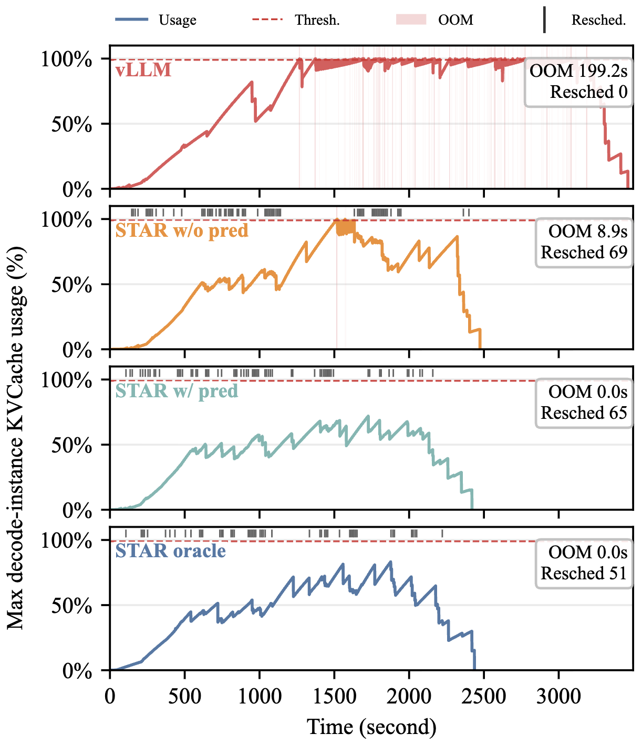
RELIABILITY
Foresight prevents KV-cache cascades.
System
Runtime behavior
vLLM
Many OOM events; cascading recomputation
STAR w/o pred.
Fewer OOMs after migration
STAR w/ pred.
Zero OOM; migrates before threshold
Oracle
Upper-bound behavior
Less OOMs
Less rescheds
Avoiding OOM prevents recomputation, tail spikes, and cascading instability.
KV-cache usage and OOM events over time
STAR: Decode-Phase Rescheduling for LLM Inference
53

Slide 54
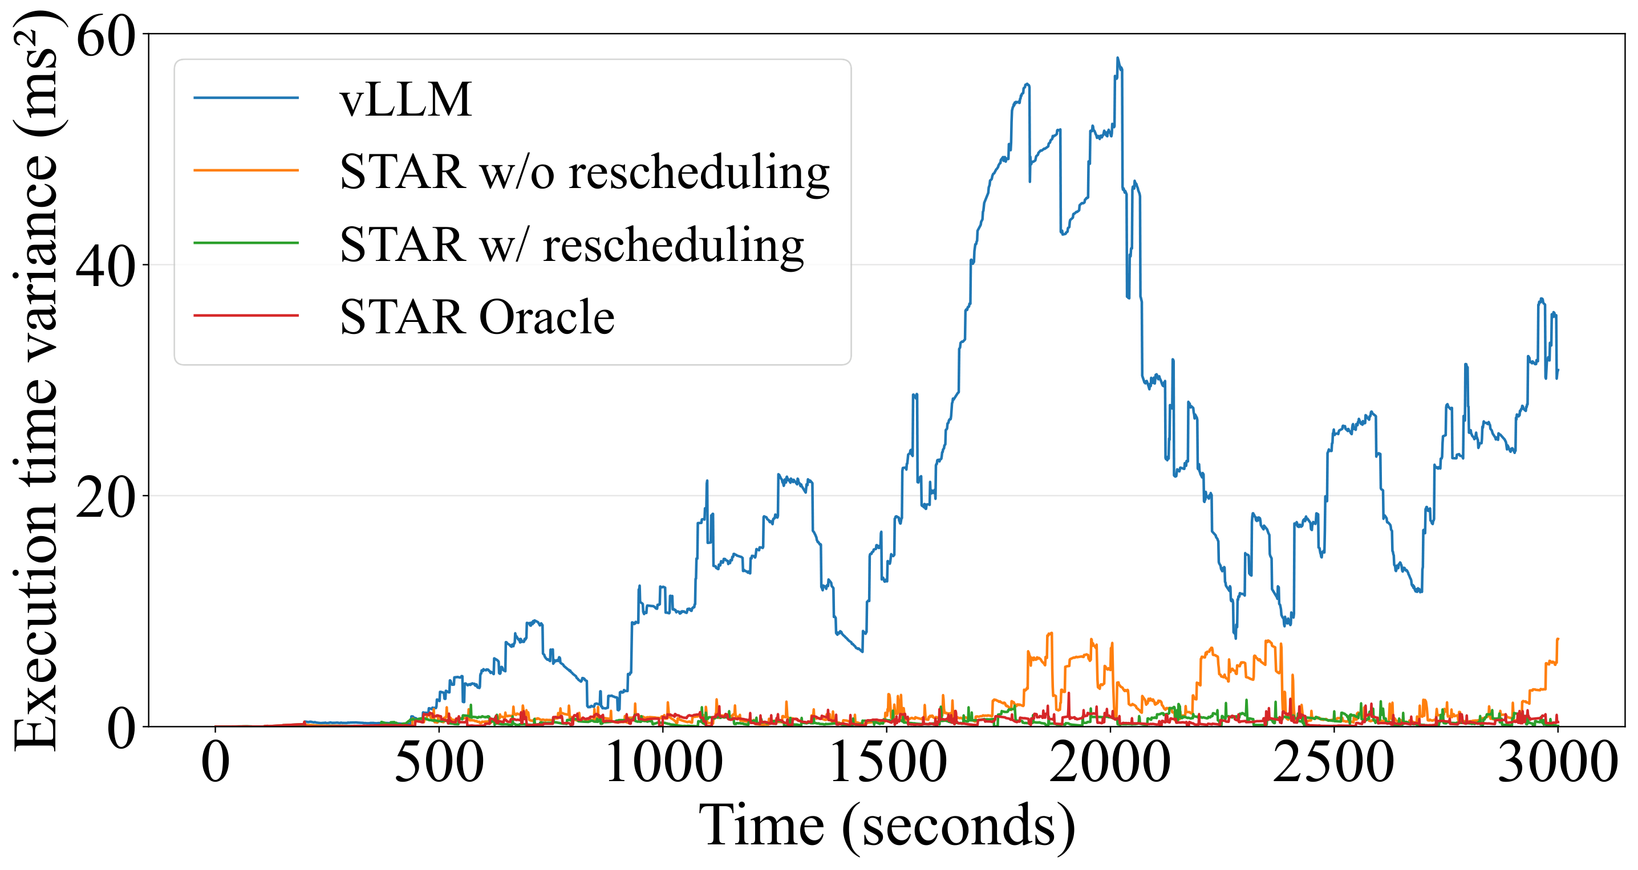
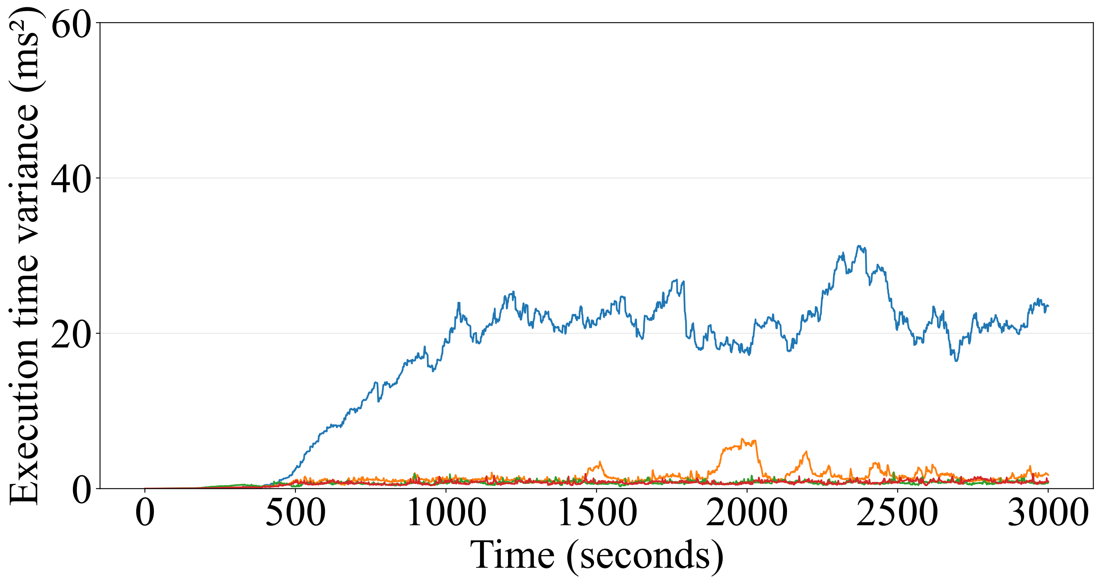
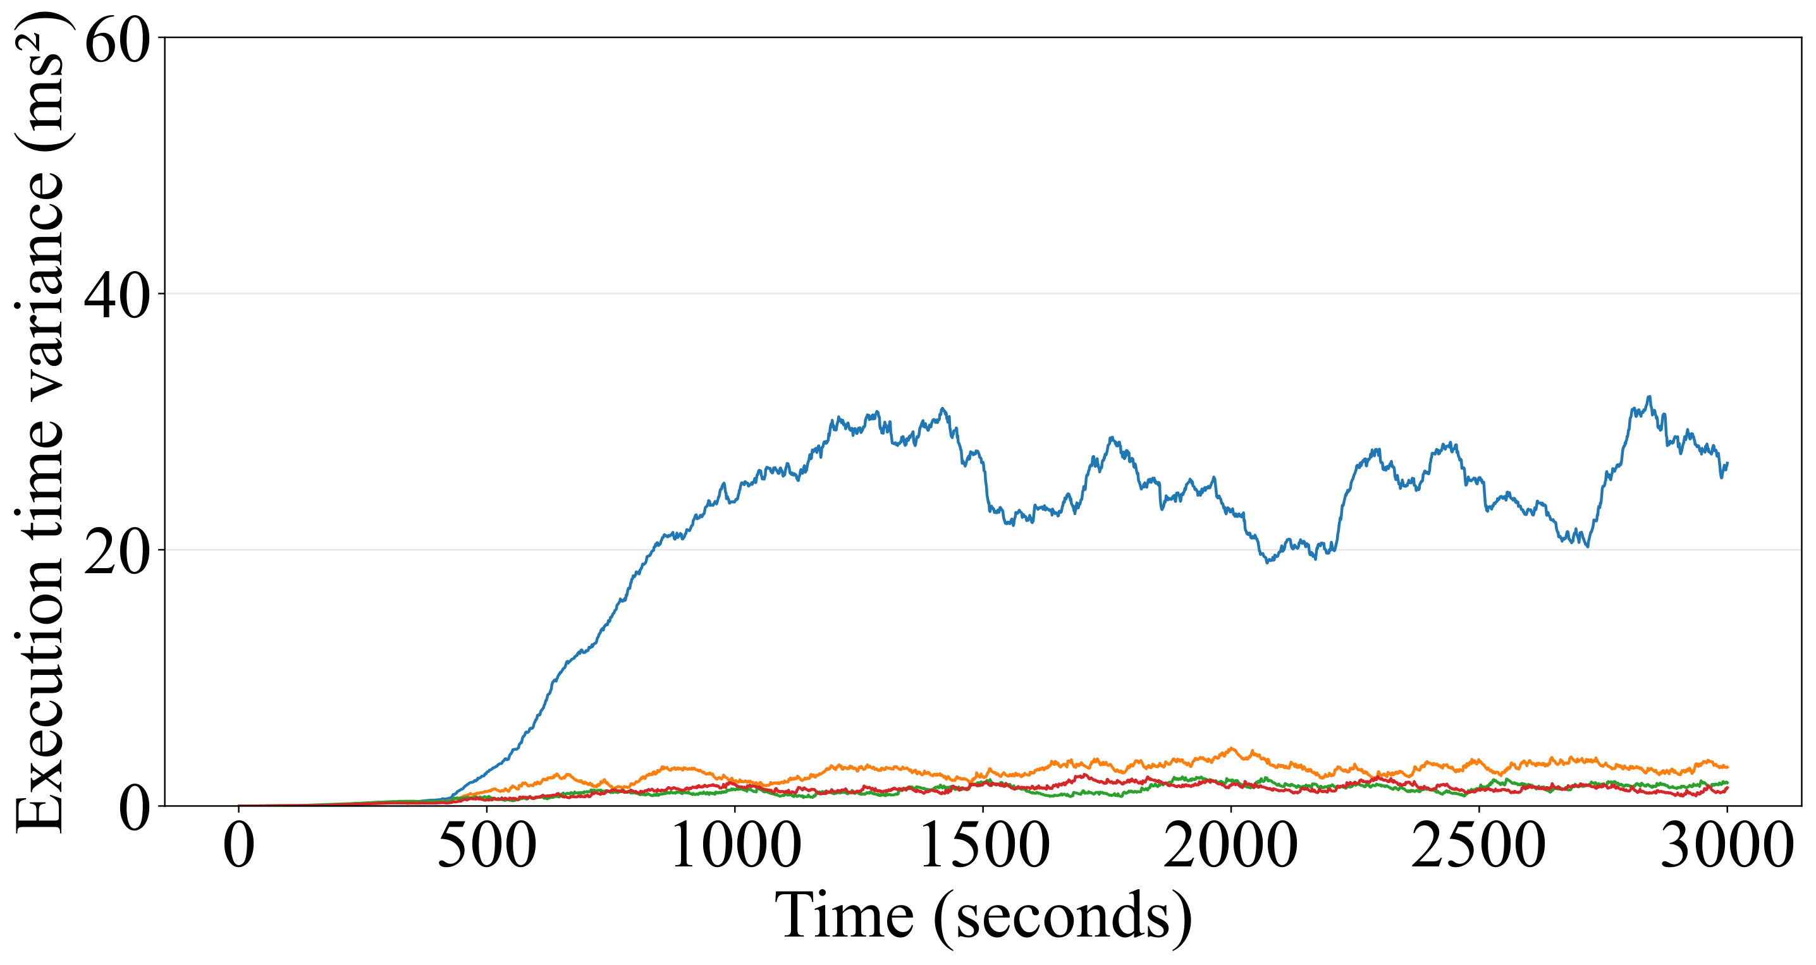
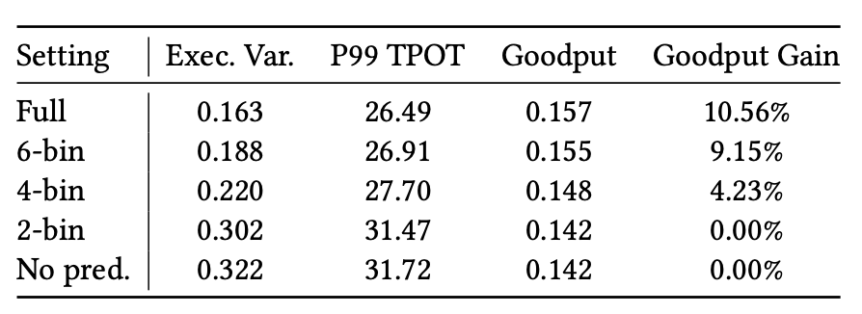
SCALABILITY AND ROBUSTNESS
STAR scales under coarser prediction.
Large-scale simulation snapshots
8 total instances (2P + 6D)
64 total instances (16P + 48D)
256 total instances (64P + 192D)
Scale: 8-256 instances, 2P+6D to 64P+192D, 25Gbps KV transfer.
Rescheduling reduces imbalance; prediction stays close to oracle.
Prediction robustness
STAR does not require exact token-count regression
but does require sufficient granularity.
STAR: Decode-Phase Rescheduling for LLM Inference
54

Slide 55
Outline
01
Motivation
Why does long-output serving break static handoff?
02
Design
How can STAR predict and rebalance decode work?
03
Evaluation
Does STAR improve goodput, tail TPOT, and reliability?
04
Takeaways
What should serving systems remember from STAR?
CURRENT SESSION
What are the core lessons from STAR?
STAR: Decode-Phase Rescheduling for LLM Inference
55

Slide 56
TAKEAWAYS
Takeaways
01
Observation
STAR: prediction-driven decode rescheduling
Long outputs shift the serving bottleneck from prefill to decode.
02
Mechanism
Hidden states cheaply predict remaining length.
03
Impact
Prediction turns runtime state into safe migration decisions.
STAR improves goodput and tail TPOT while avoiding unsafe migrations.
STAR: Decode-Phase Rescheduling for LLM Inference
56

